Slide 1
Oklahoma State Department of Health (OSDH) COVID-19 Resources
COVID-19 Resources
- OSDH guide of recommendations for healthcare providers and facilities
https://coronavirus.health.ok.gov/sites/g/files/gmc786/f/20081oc_-_coronavirus_guidance_for_health_care_providers-final.pdf
- OSDH guide for childcare facilities
https://coronavirus.health.ok.gov/articles/osdh-issues-new-covid-19-guidance-oklahoma-child-care-facilities
- OSDH Oklahoma COVID-19 Resource Page
https://govstatus.egov.com/oklahoma-coronavirus-information
- OSDH flyer to avoid ER unless essential
https://coronavirus.health.ok.gov/sites/g/files/gmc786/f/er_messaging-eng.jpg
Centers for Disease Control (CDC) COVID-19 Resources
- CDC home webpage on COVID-19 resources
https://www.cdc.gov/coronavirus/2019-ncov/index.html
- CDC guidance for school settings
https://www.cdc.gov/coronavirus/2019-ncov/community/schools-childcare/index.html
- CDC print resources for COVID-19
https://www.cdc.gov/coronavirus/2019-ncov/communication/factsheets.html
- CDC implementation of mitigation strategies for communities with COVID-19 Transmission
https://www.cdc.gov/coronavirus/2019-ncov/downloads/community-mitigation-strategy.pdf

Slide 2
COVID-19 Resources Continued
Center to Advance Palliative Care (CAPC) COVID-19 Resources
- COVID-19 Palliative Care toolkit
https://www.capc.org/toolkits/covid-19-response-resources/?fbclid=IwAR3yJM7wgHnbIram3kckfJCRuFFxjW9fDNrdKyy8JkkpDHVHWQH-Vi6Sdhk
COVID-19 Helplines
https://211oklahoma.org
https://coronavirus.health.ok.gov/sites/g/files/gmc786/f/mentalhealthresources-01.png
World Health Organization (WHO) COVID-19 Resources
- Critical preparedness, readiness, and response actions
https://www.who.int/emergencies/diseases/novel-coronavirus-2019/technical-guidance/critical-preparedness-readiness-and-response-actions-for-covid-19
- Clinical care; Patient management
https://www.who.int/emergencies/diseases/novel-coronavirus-2019/technical-guidance/patient-management
- Technical guidance
https://www.who.int/emergencies/diseases/novel-coronavirus-2019/technical-guidance

Slide 3
COVID-19 Resources Continued
National Institututes of Health (NIH) COVID-19 Resources
- NIH webpage of resources
https://www.nih.gov/health-information/coronavirus
- NIH guide for healthcare professionals
https://www.nih.gov/health-information/coronavirus
National Foundation for Infectious Diseases (NFID) COVID-19 Resources
- COVID-19 information
https://www.nfid.org/infectious-diseases/coronaviruses/
Tulsa Health Department (THD) COVID-19 Resources
- Tulsa COVID-19 case demographics
https://www.tulsa-health.org/COVID19

Slide 4
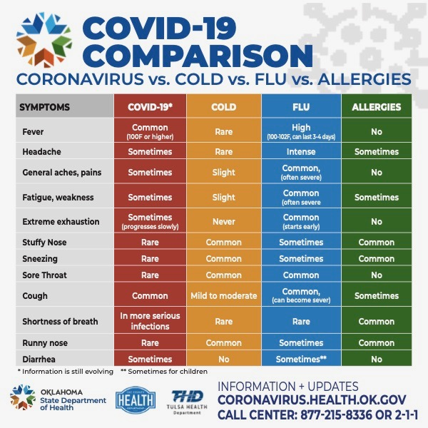
COVID-19 Resources Continued
National Institututes of Health (NIH) COVID-19 Resources
https://www.nih.gov/health-information/coronavirus
- NIH guide for healthcare professionals
https://www.nih.gov/health-information/coronavirus
National Foundation for Infectious Diseases (NFID) COVID-19 Resources
https://www.nfid.org/infectious-diseases/coronaviruses/
Tulsa Health Department (THD) COVID-19 Resources
- Tulsa COVID-19 case demographics
https://www.tulsa-health.org/COVID19

Slide 5
Centers for Disease Control (CDC) COVID-19 Resources
COVID-19 Resources for Education
Oklahoma State Department of Health (OSDH) COVID-19 Resources
- OSDH guide for childcare programs, schools, to prevent transmission
https://www.tulsa-health.org/sites/default/files/2020-03/031620_Schools_Childcare_Guidance_ENG.pdf
- OSDH guide adapted from the CDC (Centers for Disease Control) for US Institutions of Higher Ed. For Administrators of Colleges and Universities
https://www.tulsa-health.org/sites/default/files/2020-03/20078OC%20-%20Coronavirus%20Guidance%20for%20Colleges%20and%20Universities-FINAL.pdf
- CDC guide for schools and childcare programs
https://www.cdc.gov/coronavirus/2019-ncov/community/schools-childcare/index.html
- CDC guide for K-12 schools and administrators of private and public childcare programs
https://www.cdc.gov/coronavirus/2019-ncov/community/schools-childcare/guidance-for-schools.html

